Slide 1
Delete Before Submission - Project Requirements
Make sure to submit your presentation- LATE SUBMISSIONS WILL BE PENALIZED in 30 minute increments!)
Overview:
There are two components to the project remaining:
1. Final group presentation (Slides due 2 hours before class on the day of your presentation)
2. Group write-up in the form of a tri-fold brochure -- due via Group Brochure assignment
Presentation Guidelines (13 points):
Give your pitch for the overall project- Sell it! (And have fun with it- make us want your product)
Walk through the major user stories.
Reflect: Which of the ideas & processes taught in the class worked best/worst in your project?
What, if anything, would you do differently?
We may ask you a few questions
Each member of the group needs to participate in the presentation for at least a minute.
Shoot for 20 minutes, no exceptions
For example, if you have a 5-person team, you could have two members each present a user story, two members combined present one large story, and one member talk about the SWE processes your group followed and what you would have changed
Demos are encouraged but not required.
* Group members who are not present for the presentation or who do not participate for at least 1 minute in the presentation will receive a 0.
Submit a pdf of your presentation. Due 2 hours before class on the day of your presentation.

Slide 2

UCCS RideShare
Final Presentation

Slide 3
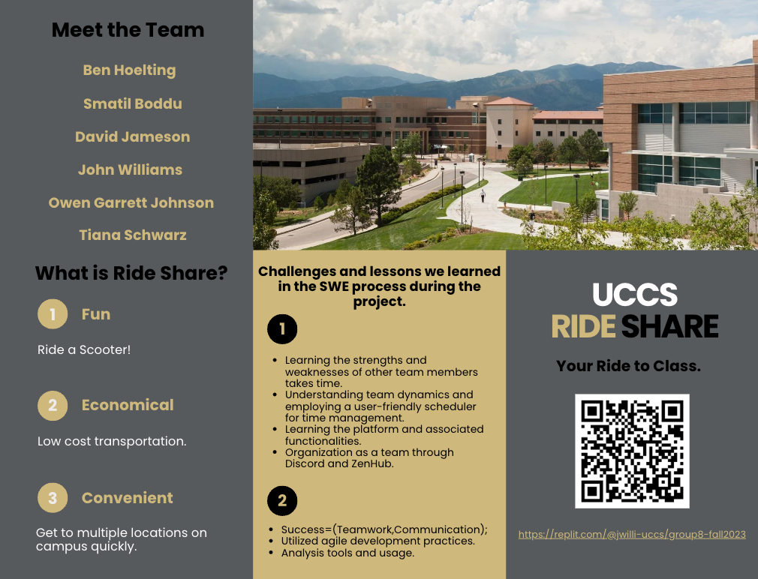

Slide 4
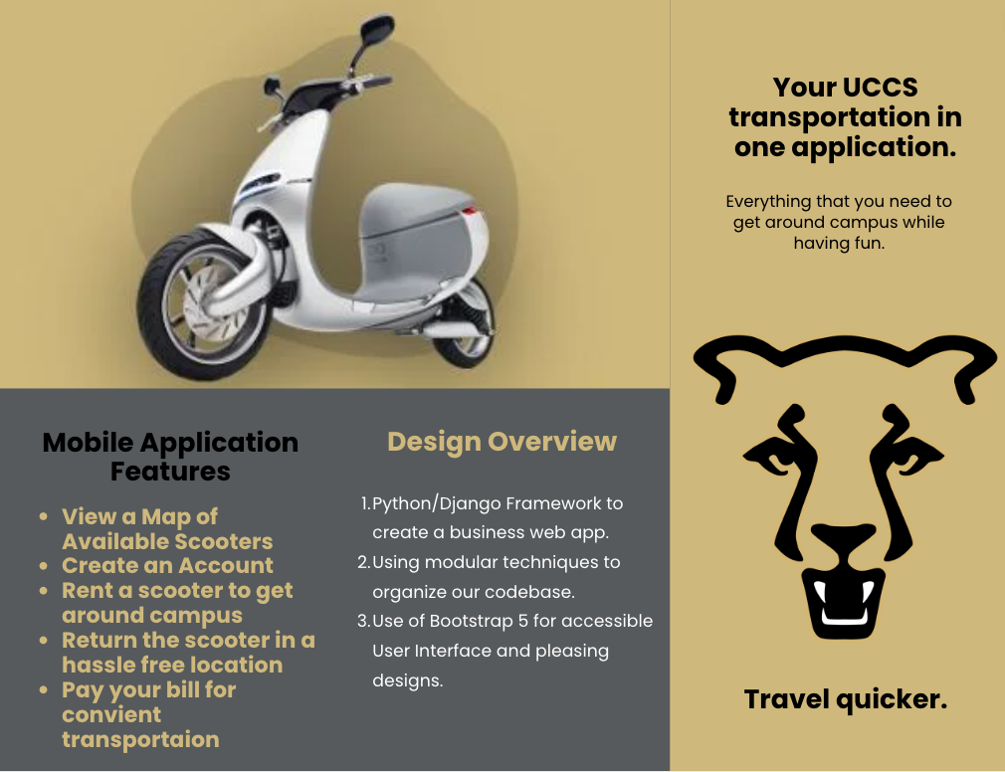

Slide 5
UCCS RIDESHARE User Story Roadmap
CS 4300/5300 F2023 Group 8
MILESTONE
MILESTONE
MILESTONE
MILESTONE
Project & App Setup
Check Out Vehicle
Paying Bills
Refactor
MILESTONE
MILESTONE
MILESTONE
MILESTONE
Sign Up / Sign In
Check In Vehicle
User Profile
More Testing
MILESTONE
MILESTONE
MILESTONE
MILESTONE
PROJECT
START
View Vehicle Map with Status
Code Analysis
Code Analysis
Final Presentation
10/26
10/29
11/1
11/3
11/6
11/11
11/17
11/19
11/21
11/26
12/1
12/5
12/8
S1
S2
S3
S4
First Implementation & Testing
More Features & Analysis
More Features & Evaluation
Final Touches

Slide 6
Major User Stories (Ben)
Create Account with UCCS Ride Share:
As an Adult with a UCCS account who needs to use the UCCS Ride Share App
I want to be able to create an account with UCCS Ride Share
So that I can use the UCCS Ride Share App.

Slide 7
Major User Stories (John)
View the real-time GPS location of all available vehicles on a map:
As a UCCS Ride Share User,
I want to be able to view the real time GPS location of all available vehicles on a map,
So that I can decide if one is available and close enough to use

Slide 8
Major User Stories (David)
As a UCCS Ride Share member,
I want a feature that allows me to check out an electric scooter on campus,
so that I can use the scooter to get around on campus.

Slide 9
Major User Stories (Owen)
As a UCCS Ride Share member who has checked out a vehicle,
I want a feature that allows me to check in the vehicle I previously checked out,
so I will no longer be billed for its use or be held responsible for the vehicle

Slide 10
Major User Stories (Smatil)
As a UCCS Ride Share member,
I want to see my payment history,
so that I can keep track of my spending habits.

Slide 11
Major User Stories (Tiana)
As a UCCS Ride Share member,
I want a feature that allows me to change my password,
so that I can keep my Profile safe from hackers.

Slide 12
Reflection: What Ideas From Class Worked Best
LoFi mocks and Storyboards
BDD worked really well for creating User Stories
Agile (communication with customer and short sprints)
Pair Programming
Live Meetings
Branching and frequent push/pull to/from GitHub (merging could be a pain though)
TDD for creating automated test
Test and Code Analysis
Discord for team and customer communication
Frequent feedback from customers and other team members
Using ZenHub for Program Management

Slide 13
Try UCCS RideShare:
Trifold Brochure (Viewing Link):
https://replit.com/@jwilli-uccs/group8-fall2023
https://tinyurl.com/bde85pr7

